Slide 1
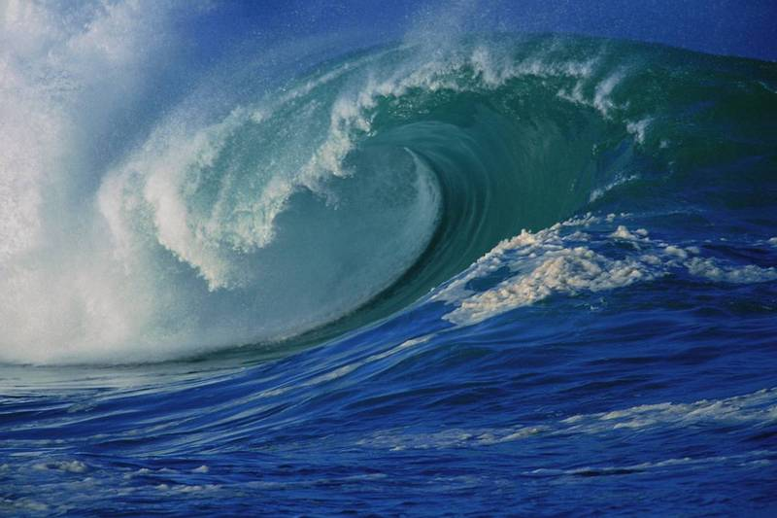
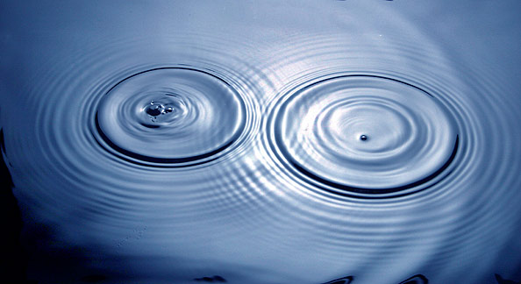
waves

Slide 2
Waves
Wave – a periodic disturbance in a solid, liquid, or gas as energy is transmitted.
Waves transfer energy!
A wave does not carry matter . It only moves matter as it travels through it.

Slide 3
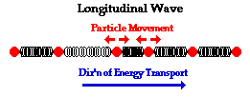
Waves
Compression (longitudinal) waves are waves in which the particles of the medium move in a direction parallel to the direction the waves move.
Medium – the substance or material that carries the wave

Slide 4
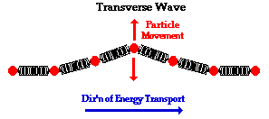
Waves
Transverse waves are waves in which particles of the medium move in a direction perpendicular to the direction the waves move.

Slide 5
Waves
Surface waves are waves in which the particles of the medium go through circular motions.
Water waves on the ocean’s surface

Slide 6
Parts of Longitudinal Waves
Compression - When the particles of a longitudinal wave are close together.
Rarefaction - When the particles of a longitudinal wave are far apart.

Slide 7
Waves
Wavelength – Distance between one point on a wave and the exact same place on the next wave. (measure in m)
Period – the time it takes two crests or compressions to pass a fixed point

Slide 8
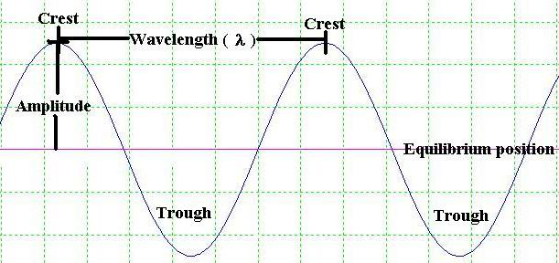
Parts of Transverse Waves
Crest - The highest point of a transverse wave.
Trough - The lowest point of a transverse wave.
Amplitude – How far the medium moves from rest (equilibrium).

Slide 9
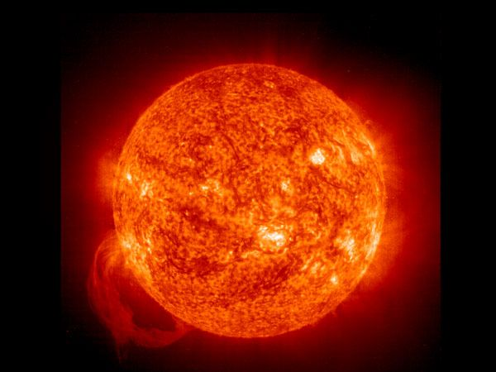
Types of Waves
Electromagnetic waves can transmit energy through a vacuum.
Vacuum – empty space (no air or other medium)
Example –
Waves from the
sun travel through
Outer space

Slide 10
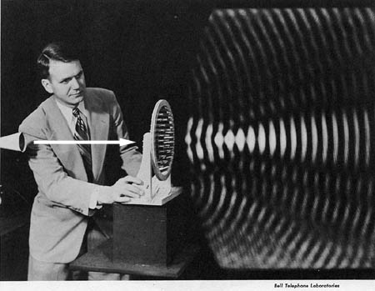
Types of Waves
Mechanical waves can NOT transmit energy through a vacuum. They must have a medium to transport the waves
Examples –
Sound waves
travel through air
Water waves

Slide 11
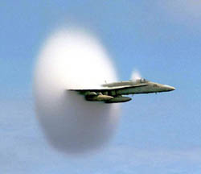
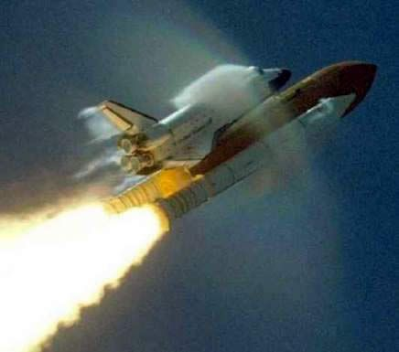
Sonic Boom!

Slide 12
Wave Velocity
f
λ

Slide 13
Relationships

Slide 14
Changing Wave Direction

Slide 15
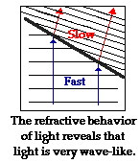
Refraction
Refraction is when a wave bends (such as when the medium it is traveling through changes)

Slide 16
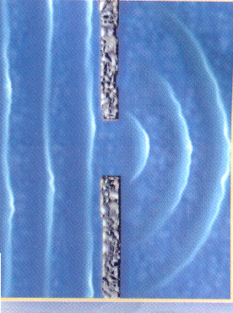
Diffraction
Diffraction is when a wave bends around an object (such as when the medium it is traveling through runs into a barrier)

Slide 17
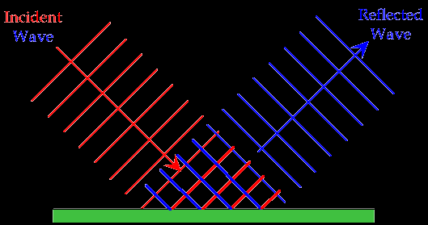
Reflection
Reflection is when a wave bounces off of a surface (such as a mirror or an echo)

Slide 18
Interference
Interference is when a wave bounces off of a surface (such as a mirror or an echo)

