Slide 1
Daily Review: 8/14
Fill in the blank. You only have to write the word
The hydrosphere is made up of all ___________ on earth.
All energy for life on earth comes from the ________.
The ___________________ is the rocky portion of earth’s surface and its interior.
Birds fly in a sphere called the _________________.
Humans are a part of a sphere called the ____________________.

Slide 2
Earth’s Role in Space
A celestial body

Slide 3
Earth Formation
Big Bang & Birth of the Earth – YouTube

Slide 4
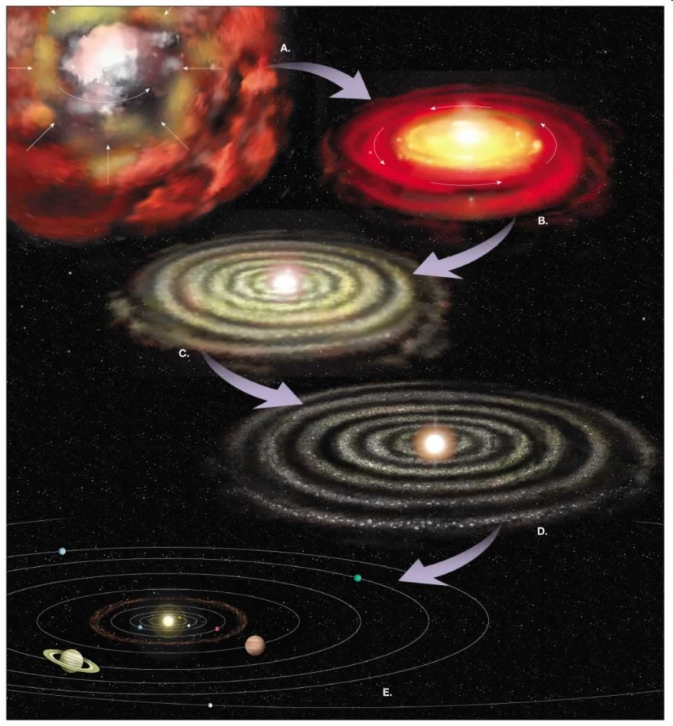
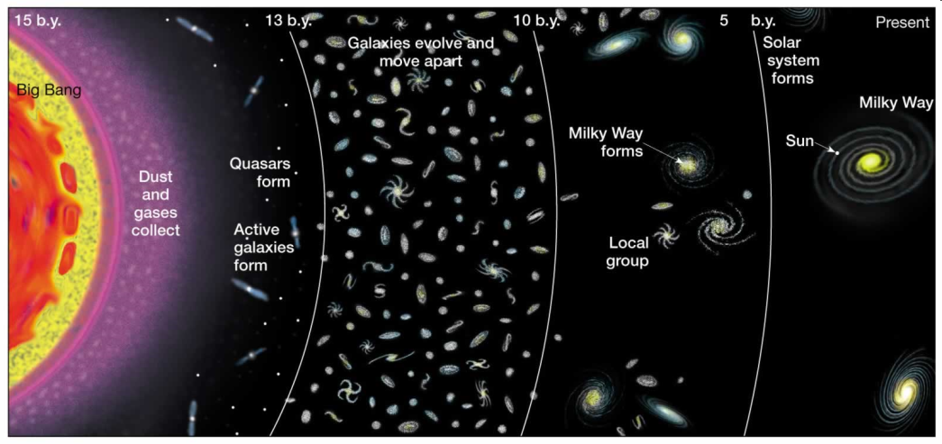
How was Earth formed?
The big bang theory
The nebular hypothesis

Slide 5
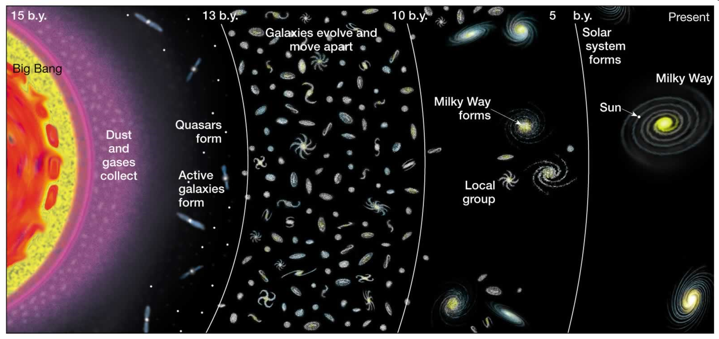
Big Bang Theory
13.7 billion years ago
Creation of all matter
Hydrogen and Helium first
More complex elements evolved through time

Slide 6
Big Bang cont’d
Hydrogen and helium came together to form clouds
Clouds collapsed and condensed to form galaxies and galaxy clusters
Stars collapsed in supernovas and nuclear fusion produced heavier elements
big bang

Slide 7
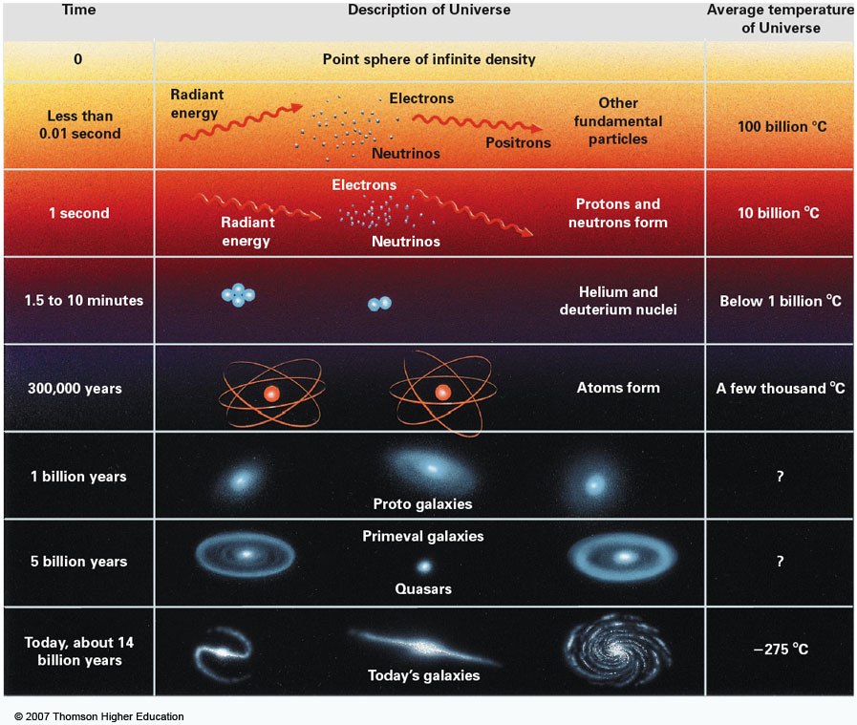

Slide 8
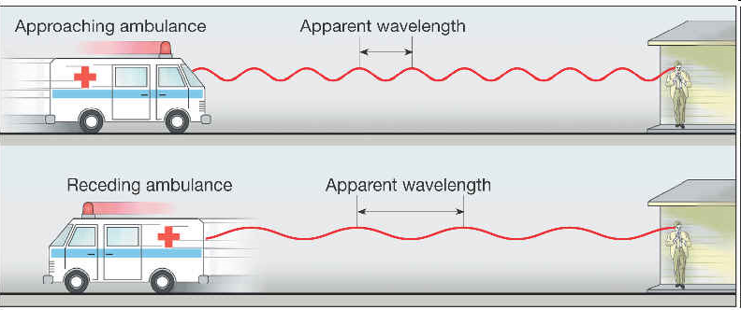
The Expanding Universe
The Doppler effect is used to document the expanding universe
doppler effect
doppler effect

Slide 9
Red shift
red shift

Slide 10
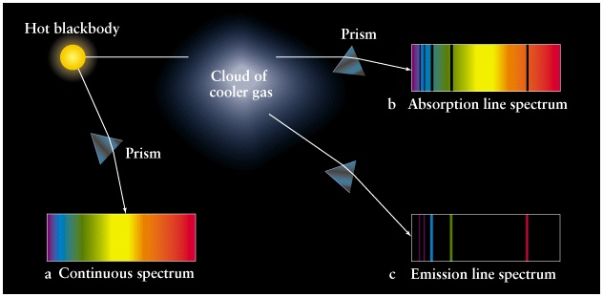
Spectroscopy
The study of the properties of light that depend on wavelength
Continuous spectrum: band of uninterrupted color
Absorption spectrum: light passed through a gas a low pressure and the gas absorbs certain wavelengths leaving dark lines
Emission Spectrum: Bright lines of particular wavelengths. Same location as dark lines in absorption spectrum

Slide 11
Spectroscopy Cont’d
Stars can be analyzed using spectroscopy
Elements on earth emit certain wavelengths
These spectrums can be matched to emissions from stars
All wavelengths from stars are shifted toward the red side of the spectrum

Slide 12
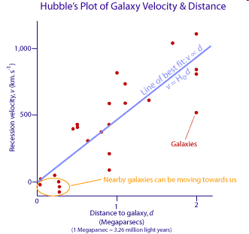
Hubble’s Law
Red shift is related to distance
The farther galaxies are moving faster than the closer galaxies
All galaxies are red shifted

Slide 13
The Nebula Hypotheses

Slide 14
The Nebular Hypothesis
Nebula Hypothesis
The solar system began as a giant cloud of dust made mostly of H and He with a small percentage of heavier elements
Cloud, called a nebula, rotated and collapsed toward the center generating heat that formed the sun
Cooling allowed rocky and metallic elements to form tiny particles

Slide 15
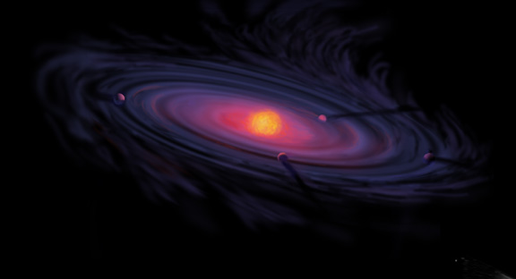
The Nebular Hypothesis cont’d
Repeated collisions of heavy particles formed asteroid sized bodies.
These asteroids combined to form the 4 inner planets, Mercury, Venus, Earth, and Mars.
Lighter materials and gases combined farther away to form the 4 outer planets, Jupiter, Saturn, Uranus, and Neptune

Slide 16
Daily Review
Write! Explain the first 3 steps of the nebular hypothesis using at least 5 complete sentences.

Slide 17
Quiz
Which branch of earth science would study the a meteor?
Is the meteor an activity, event, or instrument?
Which branch of earth science would study a hurricane?
What does geology address?
Which branch of science has not been mentioned? (hint: a scientist in this field could study you)

Slide 18
Quiz cont’d
Which sphere of earth science studies the gases surrounding our planet?
Which sphere of earth science deals with water?
The biosphere deals with all _________________ on earth.
A volcano would be a part of which sphere?
How does the volcano interact with at least 2 different spheres?

Slide 19
Nebulae: step 1
Gas (98%) and dust (2%)
Rotates and is held together by gravitational force

Slide 20
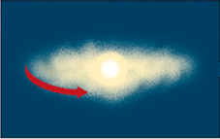
Step 2: The Nebula collapses
The collapsed mass forms a proto-sun due to gravitational force
Contraction increases speed of rotation: collapse

Slide 21
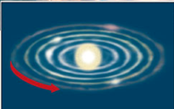
Step 3: sun is formed, disk cleared
The disk is “cleared out” due to the immense amount of energy released.
Sun is formed
Dust and gases cool and condense in defined orbits around the sun

Slide 22
Nebula hypothesis: step 4- planet formation
Temperature differences with respect to distance from sun
Closer, where temperatures are higher, iron and silicates condense
Farther, cooler, hydrogen, water condense
material collides and accretes forming planetesimals (small planets)
nebular hypothesis again

Slide 23
Evidence: Orion Nebula
Third star down on Orion’s belt
100 light years across (1 light year equals 6 trillion miles)
Reflection of dust and hydrogen

Slide 24
Evidence: Collapsed nebulae discs found in the Orion nebula
Gaseous disks are circling proto-suns.
2-17 times larger than our solar system
About 153 protoplanetary disks found in the Orion Nebula

Slide 25
Early Earth
Homogenous
Very hot

Slide 26
Segregation of elements: gravitational force
Compositionally distinct layers
Physically distinct layers
Remember: the liquid outer core with the Earth’s rotation produces the magnetic field.

Slide 27
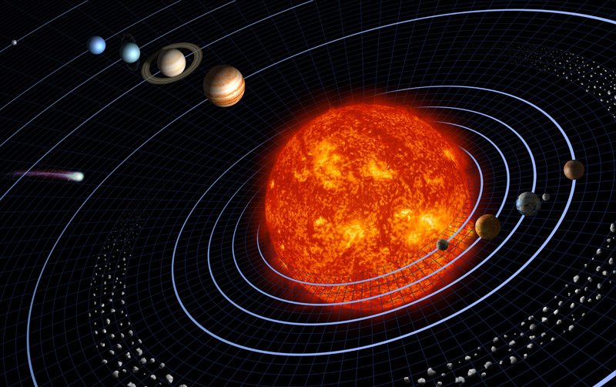
Hierarchy of the Universe
Universe: everything that exists or is known to exist, composed of galaxies
Galaxy: a group of stars or stellar material
Stars: luminous body in space composed of gases
Solar System: Some stars have planetary systems orbiting them due to gravity
Planet: celestial body orbiting a star
Example: Earth

Slide 28
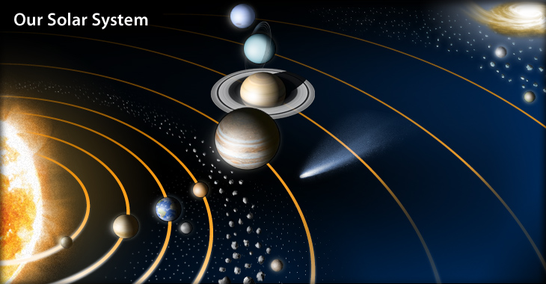
Planets from the Sun
Mercury
Venus
Earth
Mars
Jupiter
Saturn
Uranus
Neptune

Slide 29
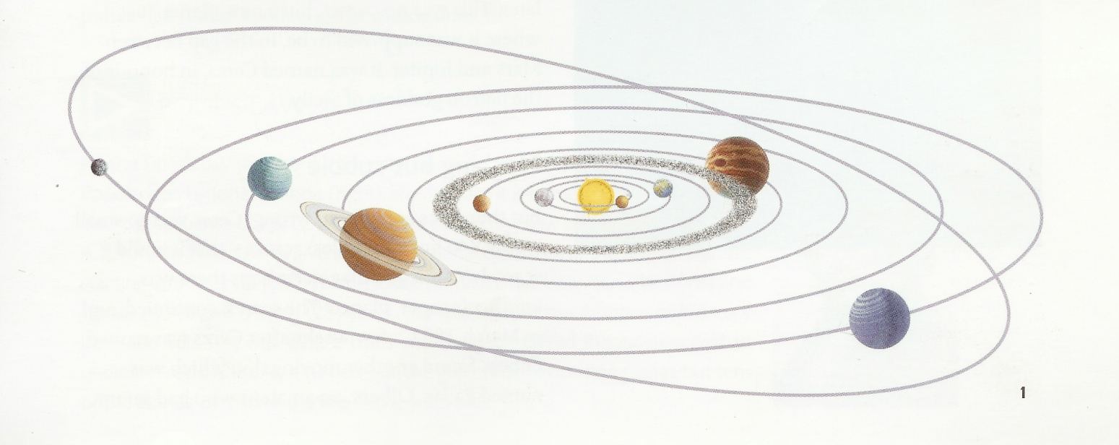
Kepler’s Laws and Planetary Orbits
1st: path of each planet around the sun is an ellipse

Slide 30
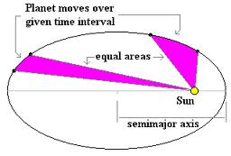
Kepler’s laws Cont’d
2nd: Each planet revolves so an imaginary line connecting the planet to the sun sweeps an equal area over equal time intervals

Slide 31
Kepler’s laws Cont’d
3rd: The time it takes a planet to orbit the sun and it’s distance to the sun are proportional
The planet’s distance from the sun is measured in astronomical units (AU)
1 is the distance between the earth and sun
About 150 million kilometers
A planet’s orbital period squared is equal to its average distance cubed
P²=a³
Kepler's Laws

